Slide 1
Object Oriented Software Engineering (OOSE)
22CS017
Introduction to Design concepts and Analysis

Slide 2
Index
Design concepts and model
Data design, Quality Software
Design Principles
Architectural design
Design class based components
User interface analysis and its design

Slide 3
Objectives
Outline the concepts and principles underpinning design
Abstraction and Refinement
Modularity
Cohesion and Coupling
Information Hiding
Present some criteria for good design
Figure 1: Criteria for Good design
analysis
design
code
test
test

Slide 4
Overview of Design
What is it?
A meaningful engineering representation of something that is to be built.
Who does it?
Software engineers with a variety of skills, ranging from human ergonomics to computer architecture
Why is it important?
A house would never be built without a blueprint.
Why should software?
Without design the system may fail with small changes, is difficult to test and cannot be assessed for quality
What is the work product?
A design specification

Slide 5
Designing Quality Software
Design is the stage where quality is introduced
Design is assessed by formal review or walkthrough
Characteristics of a good design:
Must implement explicit requirements and accommodate implicit requirements
Must be a readable and understandable guide for coding and testing
Should provide a complete picture of the software from an implementation perspective

Slide 6
Generic Design Process
The design process involves:
Diversification (acquisition of alternatives)
Followed By
Convergence (elimination of all but one particular configuration)
All design methods have the following characteristics:
A mechanism for the translation of the analysis model into a design representation
A notation for representing functional components and their interfaces
Heuristics for refinement and partitioning
Guidelines for quality assessment

Slide 7
Where Do We Begin?
modelling
Prototype
Spec
Design
Figure 2: Beginning Steps

Slide 8
Design Principles
The Design process and spec should:
Avoid ‘tunnel vision’
Be traceable back to analysis
Not reinvent the wheel
“Minimize the intellectual distance” between the problem and the solution
Exhibit uniformity and integration (look like the work of a single designer)
Accommodate change
Degrade gently
Be assessed for quality as it is being created, not after the fact
Not miss the forest (not focus too much on details)
Recognize that design is not coding, coding is not design

Slide 9
Abstraction and Refinement
Abstraction:
“Abstraction permits one to concentrate on a problem at some level of generalization without regard to irrelevant low level details..”
Software Engineering is a process of refining abstractions
Modern programming languages allow for abstraction, e.g. abstract data types
Types: data, procedural and control
Stepwise refinement
gradual top-down elaboration of detail
Abstraction and refinement are complementary.
Abstraction suppresses low-level detail while refinement gradually reveals it.

Slide 10
Data Abstraction
A named collection of data that describes a data object
door
manufacturer
model number
type
swing direction
inserts
type
lights
weight
number
Opening mechanism
implemented as a data structure
Figure 3: Data Abstraction

Slide 11
Procedural Abstraction
A named sequence of instructions with a specific and limited function
open
details of enter
algorithm
implemented with a "knowledge" of the
object that is associated with enter
Figure 4: Procedural Abstraction

Slide 12
Stepwise Refinement
Process of elaboration, proposed by Niklaus Wirth, that decomposes a high-level statement of function until low-level programming language statements are reached
open
1. walk to door;
2. reach for knob;
repeat until door opens
3. open door;
turn knob clockwise;
4. walk through;
if knob doesn't turn, then
5. close door.
take key out;
find correct key;
insert in lock;
endif
pull/push door
move out of way;
end repeat
Figure 5: Stepwise Refinement

Slide 13
Modularity
Beware the Monolith
Software should be split into separately named and addressable components
A Module is “a lexically contiguous sequence of program statements, bounded by boundary elements, having an aggregate identifier” [Yourdon and Constantine 1979]
Procedures, functions and objects are all modules

Slide 14
Benefits of Modularity
Easier to build; easier to change; easier to fix
“Modularity is the single attribute of software that allows a program to be intellectually manageable”
Don’t overdo it. Too many modules makes integration complicated
Sometimes the code must be monolithic (e.g. real-time and embedded software) but the design still shouldn’t be
Effective modular design is achieved by developing “single minded” (highly cohesive) modules with an “aversion” to excessive interaction (low coupling)

Slide 15
Modularity: Trade-offs
What is the "right" number of modules for a specific software design ?
module development cost
cost of
software
module
integration
cost
optimal number
number of modules
of modules
Figure 6: Modularity

Slide 16
Modularity Support
A design method supports effective modularity if it evidences:
Decomposability - a systematic mechanism for decomposing the problem
Composability - able to reuse modules in a new system
Understandability - the module can be understood as a standalone unit
Continuity - minimizes change-induced side effects
Protection - minimizes error-induced side effects

Slide 17
Cohesion
Def: the degree of interaction within a module
A measure of functional strength; strive for high cohesion
Terminology:
Action = the behaviour of a module (e.g. compute square root)
Logic = how the module performs its action (e.g. using Newton’s method)
Context = specific usage of the module (e.g. find square root of a double precision integer)

Slide 18
Types of Cohesion
Worst to Best
Coincidental Cohesion
Performs multiple unrelated actions
Can happen if an organization enforces rigid rules on module size - modules are hacked apart and glued together
Worse than no modularity at all
Logical Cohesion
Module tasks related logically
Example: an object that performs all input and output
Interface can be difficult to understand (e.g. printf) and code for several actions may be intertwined
Temporal Cohesion
Tasks executed within the same span of time
Example: initialization of data structures
“Scatter-brained”
Low
Moderate

Slide 19
More Types of Cohesion
Procedural
Actions are related and must be executed in a certain order
Communication
Actions are performed in series and on the same data
Example: CalculateTrajectoryAndPrint
Damages Reusability
Functional or informational cohesion
Performs exactly one action OR
Performs a number of actions, with separate entry points, all performed on the same data structure
Moderate
High
“Single-minded”

Slide 20
Coupling
Equivalent to a well-designed abstract data type or object
Def: the degree of interaction between modules
A measure of relative interdependence; strive for low coupling since this reduces the “ripple effect”
Types of Coupling (Worst to Best):
Content Coupling
One module directly references the internals of another
Example: module p branches to a local label of module q
Almost any change in one requires a change in the other
Common Coupling
Both modules have access to the same global data area
Example: module p and q have read and write access to the same database element
Suffers from all the disadvantages of global variables
High Coupling
Moderate Coupling

Slide 21
Types of Coupling
Control Coupling
Element of control is transferred between modules
Example: Module q not only passes information but also informs module
p as to what action to take
These kinds of modules often have logical cohesion
Stamp Coupling
Whole data structures (records, arrays, object) transferred
BUT the called module only operates on part of the data structure
Security Risk: allows uncontrolled data access
Data Coupling
Every argument is either a simple type or a data structure
AND all elements are used by the called module
Maintenance is easier because regression faults less likely
Moderate Coupling
High Coupling

Slide 22
Exercise: Classify the Couplings
p
Number | In | Out
1 | Aircraft type | Status flag
2 | List of parts | -
3 | Function code | -
4 | List of parts | -
5 | Part number | Part manu-facturer
6 | Part number | Part name
1
q
2
3
4
r
s
5
6
t
u
p, t, u access the same database in update mode
Figure 7: Coupling Classification

Slide 23
Information Hiding
A more accurate term would be “details hiding”
Supported by public and private specifiers in C++
Benefits of Information Hiding:
Leads to low coupling
Reduces the likelihood of “side effects”
Limits the global impact of local design decisions
Highlights communication through controlled interfaces
Discourages the use of global data
Results in higher quality software

Slide 24
Architectural Design

Slide 25
Topics covered
Architectural design decisions
Architectural views
Architectural patterns
Application architectures

Slide 26
Software architecture Definition
The design process for identifying the sub-systems making up a system and the framework for sub-system control and communication is architectural design.
The output of this design process is a description of the software architecture.

Slide 27
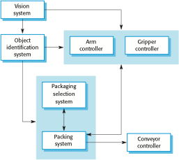
The architecture of a packing robot control system – Box and
Figure 8: Architecture of Robot Control System

Slide 28
Architectural design decisions – common questions (though a creative process)
Is there a generic application architecture that can be used?
How will the system be distributed?
What architectural styles are appropriate?
What approach will be used to structure the system?
How will the system be decomposed into modules?
What control strategy should be used?
How will the architectural design be evaluated?
How should the architecture be documented?

Slide 29
Architecture reuse
Systems in the same domain often have similar architectures that reflect domain concepts.
Application product lines are built around a core architecture with variants that satisfy particular customer requirements.
The architecture of a system may be designed around one of more architectural patterns or ‘styles’.

Slide 30
Architecture and system characteristics
Performance
Localize critical operations and minimize communications.
Security
Use a layered architecture with critical assets in the inner layers.
Safety
Localize safety-critical features in a small number of sub-systems.
Availability
Include redundant components and mechanisms for fault tolerance.
Maintainability
Use fine-grain, replaceable components.

Slide 31
4 + 1 view model of software architecture
A logical view, which shows the key abstractions in the system as objects or object classes.
A process view, which shows how, at run-time, the system is composed of interacting processes.
A development view, which shows how the software is decomposed for development.
A physical view, which shows the system hardware and how software components are distributed across the processors in the system.
Related using use cases or scenarios(+1)

Slide 32
Architectural patterns
Patterns are a means of representing, sharing and reusing knowledge.
An architectural pattern is a stylized description of good design practice, which has been tried and tested in different environments.
Patterns should include information about when they are and when there are not useful.
Patterns may be represented using tabular and graphical descriptions.

Slide 33
The user interface
User interfaces should be designed to match the skills, experience and expectations of its anticipated users.
System users often judge a system by its interface rather than its functionality.
A poorly designed interface can cause a user to make catastrophic errors.
Poor user interface design is the reason why so many software systems are never used.
33

Slide 34
Importance of User Interface
“Most important part of any computer system”
“Interface is the system for most users”
Increasingly important
GUIs a big improvement over previous approaches
Platforms (e.g. Mac/ Microsoft) have style guides
50% of code devoted to interface
Interface should “disappear” – users can focus on
their task, not the interface
Biggest enemy of good interface design is time
34

Slide 35
Graphical user interfaces
Most users of business systems interact with these systems through graphical interfaces although, in some cases, legacy text-based interfaces are still used
Characteristic | Description
Windows | Multiple windows allow different information to be displayed simultaneously on the user’s screen.
Icons | Icons different types of information. On some systems, icons represent files; on others, icons represent processes.
Menus | Commands are selected from a menu rather than typed in a command language.
Pointing | A pointing device such as a mouse is used for selecting choices from a menu or indicating items of interest in a window.
Graphics | Graphical elements can be mixed with text on the same display.
35

Slide 36
GUI advantages
They are easy to learn and use.
Users without experience can learn to use the system quickly.
The user may switch quickly from one task to another and can interact with several different applications.
Information remains visible in its own window when attention is switched.
Fast, full-screen interaction is possible with immediate access to anywhere on the screen
6

Slide 37
Human factors in interface design
Limited short-term memory
People can instantaneously remember about 7 items of information. If you present more than this, they are more liable to make mistakes.
People make mistakes
When people make mistakes and systems go wrong, inappropriate alarms and messages can increase stress and hence the likelihood of more mistakes.
People are different
People have a wide range of physical capabilities. Designers should not just design for their own capabilities.
People have different interaction preferences
Some like pictures, some like text.
7

Slide 38
Design Principles
User familiarity
The interface should be based on user-oriented terms and concepts rather than computer concepts. For example, an office system should use concepts such as letters, documents, folders etc. rather than directories, file identifiers, etc.
Consistency
The system should display an appropriate level of consistency. Commands and menus should have the same format, command punctuation should be similar, etc.
Minimal surprise
If a command operates in a known way, the user should be able to predict the operation of comparable commands
8

Slide 39
Design Principles
Recoverability
The system should provide some resilience to user errors and allow the user to recover from errors. This might include an undo facility, confirmation of destructive actions, 'soft' deletes, etc.
User guidance
Some user guidance such as help systems, on-line manuals, etc. should be supplied
User diversity
Interaction facilities for different types of user should be supported. For example, some users have seeing difficulties and so larger text should be available
39

Slide 40
Design issues in UIs
Two problems must be addressed in interactive systems design
How should information from the user be provided to the computer system?
How should information from the computer system be presented to the user?
User interaction and information presentation may be integrated through a coherent framework such as a user interface metaphor.
40

Slide 41
Interaction styles
Direct manipulation: The user interacts directly with objects on the screen, such as a mouse, touch screen
... etc
Menu selection: The user selects a command from a list of possibilities ( a menu).
Form fill-in: The user fills in the fields of a form
Command language: The user issues a special command and associated parameters to instruct the system what to do
Natural language: The user issues a command in natural language that must be parsed into command language
11

Slide 42
Interaction styles
Interaction style
Direct manipulation
Main advantages
Main disadva ntages
Application examples
Video games CAD systems
Fast and intuitive interaction
Easy to learn
May be hard to implement. Only suitable where there is a visual metaphor for tasks and objects.
Slow for expe rienced users. Can beco me complex if many menu options.
Takes up a lot of screen space. Causes problems where user options do not match the form fields.
Hard to learn.
Poor error manage ment.
Menu selection
Avoids user error Little typing required
M ost general-
purpose systems
Form fill-in
Simple data entry Easy to learn Checkab le
Stock control, Personal loan proces sing
Command language
Powerful and flexible
Op erating systems, Command and control systems
Information retrieval systems
Natural language
Accessible to casual users
Easily extended
Requires more typing.
Natural language und erstanding systems are un reliable.
12

Slide 43
Direct manipulation
Advantages
Users feel in control of the computer.
User learning time is relatively short.
Users get immediate feedback on their actions so mistakes can
be quickly detected and corrected.
Disadvantages
The derivation of an appropriate information space model can be very difficult
Given that users have a large information space, what facilities for navigating around that space should be provided?
Direct manipulation interfaces can be complex to program and make heavy demands on the computer system
13

Slide 44
Control panel interface
Title
JSD. example
Grid
Busy
Method
JSD
OUIT
Type
Network
Units
cm
Selection
Process
Reduce
Full
PRINT
NODE
LINKS
FONT
LABEL
EDIT
44
Figure 9: Control Panel Interface

Slide 45
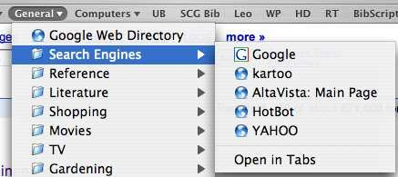
Menu systems
Users make a selection from a list of possibilities.
The selection may be made by pointing and clicking with a mouse, using cursor keys or by typing the name of the selection
May make use of simple-to-use terminals such as touchscreens
45
Figure 10: Menu system

Slide 46
Menu systems
Advantages
Users need not remember command names
Typing effort is minimal
User errors are trapped by the interface
Context-dependent help can be provided.
Problems
Actions which involve logical conjunction (and) or disjunction (or) are awkward to represent
Menu systems are best suited to presenting a small number of choices. If there are many choices, some menu structuring facility must be used
16

Slide 47
Form-based interface
NEW BOOK
Title
ISBN
Author
Price
Publication date
Number of copies
Publisher
Edition
Classification
Loan status
Order status
Date of purchase
17
Figure 10: Form Based Interface

Slide 48
Command interfaces
User types commands to give instructions to the system e.g.
UNIX
May be implemented using cheap terminals.
Easy to process using compiler techniques
Commands of arbitrary complexity can be created by command
combination
Concise interfaces requiring minimal typing can be created
Problems
Users have to learn and remember a command language. Command interfaces are therefore unsuitable for occasional users
Users make errors in command. An error detection and recovery
system is required
System interaction is through a keyboard so typing ability is required
18

Slide 49
Sample Commands in UNIX
# Find all files in /usr/bin which are not documented in
/usr/man/man1 with source in /usr/src:
% cd /usr/bin %
mv old.html new.html
gcc file.c -o file
49

Slide 50
Natural language interfaces
The user types a command in a natural language.
Generally, the vocabulary is limited and these systems are confined to specific application domains (e.g. timetable enquiries)
NL processing technology is now good enough to make these interfaces effective for casual users but experienced users find that they require too much typing
50

Slide 51
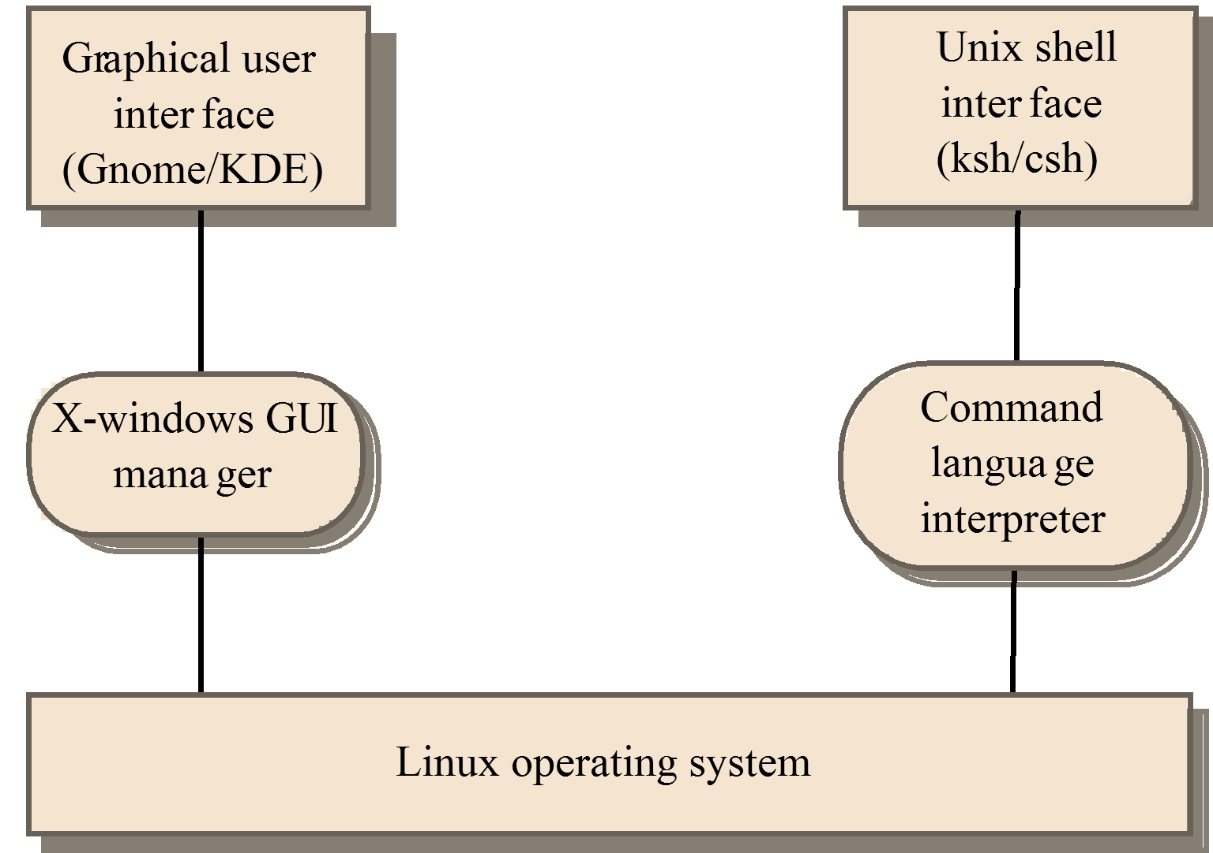
Multiple user interfaces
51
Figure 11: Multiple User Interface

Slide 52
LIBSYS interaction
Document search
Users need to be able to use the search facilities to find the documents that they need.
Document request
Users request that a document be delivered to their machine or to a server for printing.
52

Slide 53
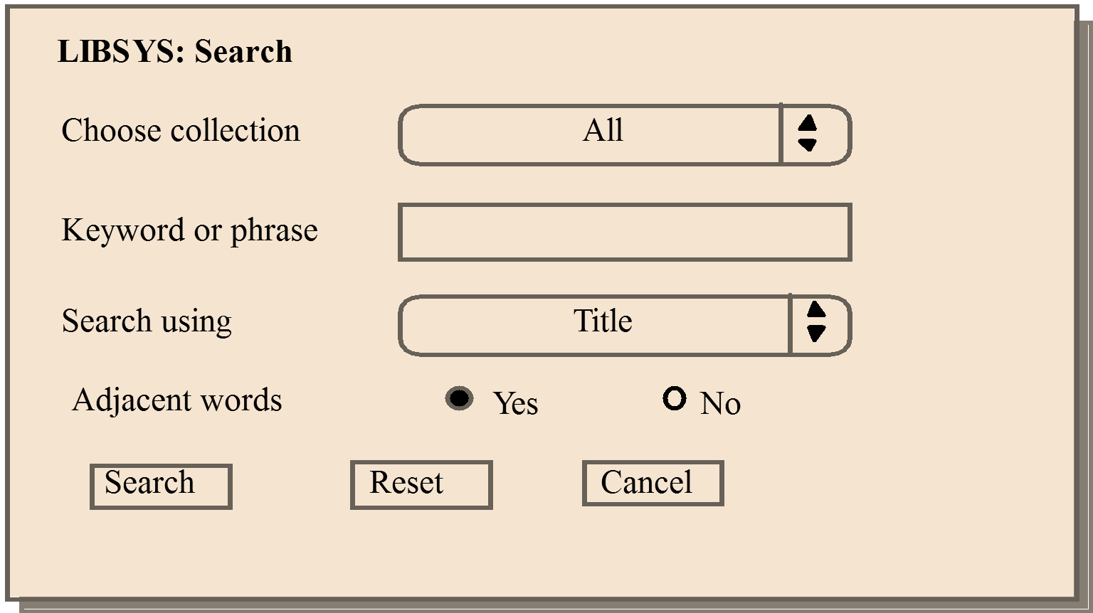
LIBSYS search form
Figure 11: LIBSYS search Form

Slide 54
Information presentation
Information presentation is concerned with presenting system information to system users.
The information may be presented directly (e.g. text in a word processor) or may be transformed in some way for presentation (e.g. in some graphical form).
54

Slide 55
Practice Questions
What Is System Design?
What is load balancing, and why is it important in system design?
How are performance and scalability related to each other?
How do you approach system design?
Which is the primary tool for structured design?
Can you name some metrics for measuring system performance?
There are basic approaches in Integration testing: Top down, bottom up. Discuss each one of them.
What are the pros and cons of bottom-up models versus top-down models?

Slide 56
THANKS
56

